Slide 1
Flutter Widgets
Introduction

Slide 2
Learning Outcomes
By the end of this lesson, you should have basic knowledge to
create flutter applications
create Stateless/Stateful widgets
style widgets
use flutter widgets such as MaterialApp, Scaffold, Text, FloatingActionButton, and Icon

Slide 3
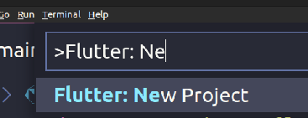
Creating New Flutter App in VSCode
Select View -> Command Palette in VSCode or
Press Ctrl+Shift+P to open the command selection window
Then start typing “Flutter: New Project” to filter the search down to the Flutter: New Project command

Slide 4
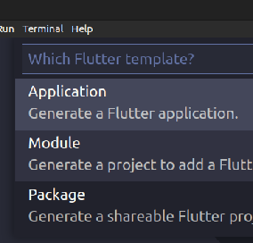
Creating New Flutter App in VSCode
Select the Application template from the listed options

Slide 5
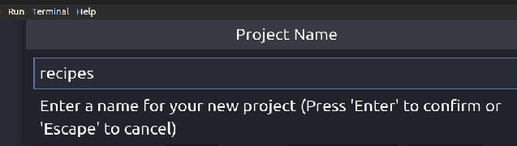
Creating New Flutter App in VSCode
Select a folder to create the project in
Give a name to the project such as recipes

Slide 6
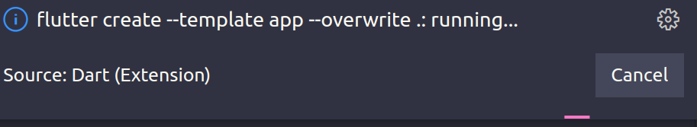
Creating New Flutter App in VSCode
Then the template project will be generated

Slide 7
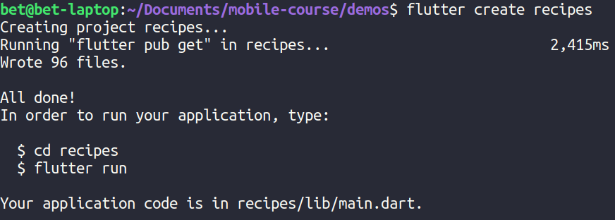
Creating New Flutter App from Command Line
You can use the flutter command to create the project from the command line
flutter create recipes

Slide 8
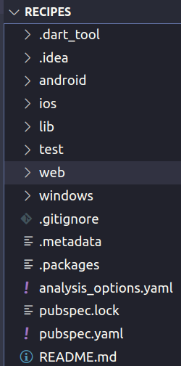
Creating New Flutter App
Once the project is created either using the IDE or the flutter command you will find the generated files in the recipes directory
The generated template project contains a working demo application

Slide 9
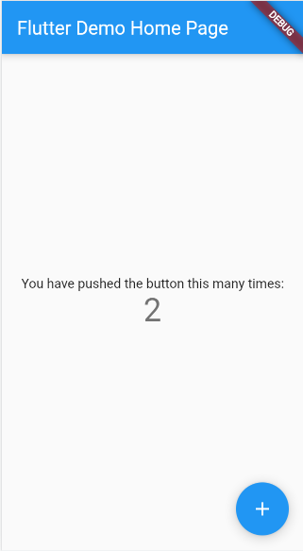
Running the Demo (Counter) App
Use VSCode or the following command to build and run the application
flutter run
You should see a screen similar to the one shown on the emulator, android device or chrome browser

Slide 10
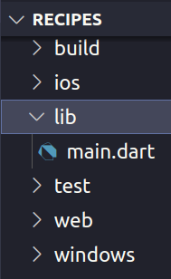
Exploring the Generated Code
The main source code file (main.dart) for the generated application is found inside the lib directory

Slide 11
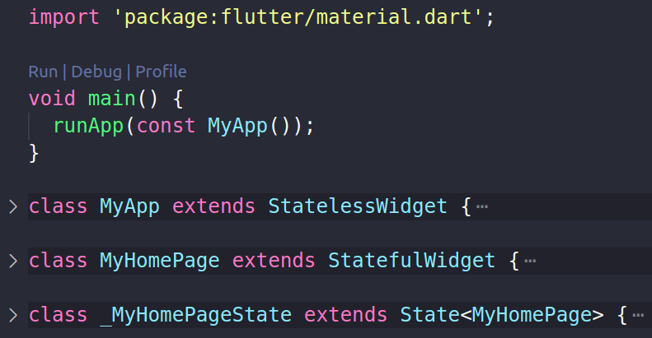
Exploring the Generated Code
The main.dart file contains the top level main() function and three classes as shown below

Slide 12
The main() function
It is the entry point for the code
void main() {
runApp(const MyApp());
}

Slide 13
The runApp() function
It sets the top-level widget of the app
It takes the given Widget and makes it the root of the widget tree
MyApp widget is now the top-level widget
void main() {
runApp(const MyApp());
}

Slide 14
StatelessWidget
A StatelessWidget doesn’t change after you build it
class MyApp extends StatelessWidget {
@override
Widget build(BuildContext context) {
return MaterialApp(
title: 'Flutter Demo',
home: const MyHomePage(title: 'Flutter Demo'),
);
}
}

Slide 15
The build() method
It is the entry point for composing together other widgets to make a new widget
@override
Widget build(BuildContext context) {
return MaterialApp(
title: 'Flutter Demo',
home: const MyHomePage(title: 'Flutter Demo'),
);
}

Slide 16
The MaterialApp widget
It uses Material Design
It wraps a number of widgets that are commonly required for material design applications
@override
Widget build(BuildContext context) {
return MaterialApp(
title: 'Flutter Demo',
home: const MyHomePage(title: 'Flutter Demo'),
);
}

Slide 17
StatefulWidget
StatefulWidget know how to generate State objects, which are then used to hold state
class MyHomePage extends StatefulWidget {
const MyHomePage({required this.title})
final String title;
@override
State<MyHomePage> createState() => _MyHomePageState();
}

Slide 18
The State class
Shown in the next slide

Slide 19
class _MyHomePageState extends State<MyHomePage> {
int _counter = 0;
@override
Widget build(BuildContext context) {
return Scaffold(
appBar: AppBar(title: Text(widget.title),),
body: Center(child: Text('$_counter',
style: Theme.of(context).textTheme.headline4,),),
floatingActionButton: FloatingActionButton(
onPressed: () => setState(() {
_counter += 1;
}),
tooltip: 'Increment',
child: const Icon(Icons.add),
),
);
}
}

Slide 20
The setState() method
class _MyHomePageState extends State<MyHomePage> {
int _counter = 0;
@override
Widget build(BuildContext context) {
return Scaffold(
// ...
floatingActionButton: FloatingActionButton(
onPressed: () => setState(() {
_counter += 1;
}),
child: const Icon(Icons.add),
),
);
}
}
tells the Flutter framework that something has changed in this State, which causes it to rerun the build method so that the display can reflect the updated value

Slide 21
Question
The Stateless Widget Class and the State class of the Stateful Widget class have build method
If you print a some debugging message on both method, how many times the message is printed in the Stateless Widget and in the Stateful Widget when you press the floating action button

